Slide 1


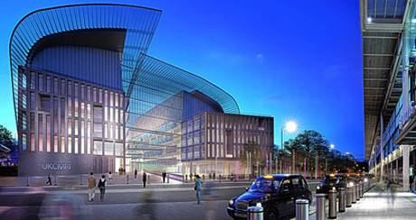
Future Worth Method

Slide 2

After studying this chapter, you should
be able to understand:
What is Future Worth Method
Numerical / Problems
L E A R N I N G O B J E C T I V E S

Slide 3

Introduction
In future worth method of comparison of alternatives, the future worth of various alternatives will be computed.
Then, the alternative with the maximum future worth of net revenue or with the minimum future worth of net cost will be selected as the best alternative for implementation.

Slide 4
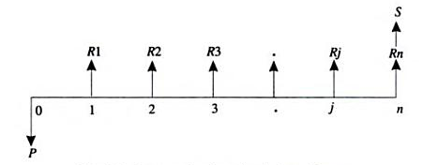
Future Worth Method
  There are two methods in calculating future worth. They are
    Revenue dominated cash flow diagram
    Cost dominated cash flow diagram
  Revenue dominated cash flow diagram :

Slide 5
Future Worth Method
  There are two methods in calculating future worth. They are
    Revenue dominated cash flow diagram
    Cost dominated cash flow diagram
  Revenue dominated cash flow diagram :
    Where,
    P – Represents initial investment ; Rj – Net revenue at the end of j^{th} year ; S – Represent the salvage value at the end of n^{th} year

Slide 6
Future Worth Method
  The formula for the future worth of the revenue based cash flow diagram for a given interest rate, i is:
  FW(i) = - P(1+i)^{n} + R1(1+ i)^{n-1} + R2(1+i)^{n-2} + … +Rj(1+i)^{n-j}
  + … + Rn + S
  In the above formula, the expenditure is assigned with negative sign and revenues are assigned with positive sign.

Slide 7
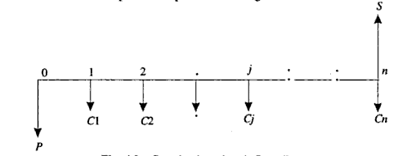
Future Worth Method
  Cost dominated cash flow diagram :
    Where,
    P – Represents initial investment
    Cj – Net cost of the operation and maintenance at the end of j^{th} year.
    S – Represent the salvage value at the end of n^{th} year

Slide 8
Future Worth Method
  The formula for the future worth of the cost based cash flow diagram for a given interest rate, i is:
  FW(i) = P(1+i)^{n} + C1(1+ i)^{n-1} + C2(1+i)^{n-2} + … +Cj(1+i)^{n-j}
  + … + Cn - S
  In the above formula, the expenditure is assigned with positive sign and revenues are assigned with negative sign.

Slide 9
Solved Problems
Consider the following two mutually exclusive alternatives:
At i = 18%, select the best alternative based on future worth method of comparison.
Alternative | End of years
 | 0 | 1 | 2 | 3 | 4
A (Rs) | - 50,00,000 | 20,00,000 | 20,00,000 | 20,00,000 | 20,00,000
B (Rs) | - 45,00,000 | 18,00,000 | 18,00,000 | 18,00,000 | 18,00,000

Slide 10
Solved Problems
A man owns a corner plot. He must decide which of the several alternatives to select in trying to obtain a desirable return on his investment. After much study and calculation, he decides that the two best alternatives are as given in the following table:
Evaluate the alternatives based on the future worth method at i=12%.
 | Gas Station | Ice Cream Stand
First Cost (Rs) | 20,00,000 | 36,00,000
Annual property taxes (Rs) | 80,000 | 1,50,000
Annual Income (Rs) | 8,00,000 | 9,80,000
Life of building (years) | 20 | 20
Salvage value (Rs) | 0 | 0

Slide 11
Solved Problems
M/S Krishna Castings Ltd. Is planning to replace its annealing furnace. It has received tenders from three different original manufacturers of annealing furnace. The details are as follows:
Which is the best alternative based on future worth method at i=20%?
 | Manufacturer
 | 1 | 2 | 3
Initial Cost (Rs) | 80,00,000 | 70,00,000 | 90,00,000
Life (years) | 12 | 12 | 12
Annual operation and maintenance cost (Rs) | 8,00,000 | 9,00,000 | 8,50,000
Salvage value after 12 years | 5,00,000 | 4,00,000 | 7,00,000

Slide 12
Solved Problems
A company must decide whether to buy machine A or machine B:
At 12% interest rate, which machine should be selected? (Use future worth method of comparison).
 | Machine
 | A | B
Initial Cost (Rs) | 4,00,000 | 8,00,000
Useful Life in years | 4 | 4
Salvage value at the end of machine life | 2,00,000 | 5,50,000
Annual maintenance cost (Rs) | 40,000 | 0

Slide 13
Solved Problems
5. A company must decide whether to select alternative 1 or 2:
Use future worth method of comparison
2.5L
3L
2 L
1.5 L
50,000
1,00,000
0
1
2
3
4
5
6
t
a) i =8 %
b) i =9%
c) i =20%
Rs. 35,00,000
3.5L
4.2L
2.8 L
2.1 L
70,000
1,40,000
0
1
2
3
4
5
6
t
a) i =8 %
b) i =9%
c) i =20%
Rs. 7,00,000

Slide 14
Solved Problems
Soln: Alternative A
Given data: P= Rs. 50,00,000/- ; A = Rs. 20,00,000/- ; Life = 4 yrs
i = 18% compounded annually
The CFD for the alternative A is shown below:
The future worth of the alternative A is given by,
FW (i%) = - P(F/P, i, n) + A (F/A, i , n)
= -50,00,000 (F/P, 18%,4) + 20,00,000 (F/A, 18%, 4)
= -50,00,000(1.939) + 20,00,000(5.215) = Rs 7,35,000/-
A= Rs. 20,00,000
0
1
2
3
4
t
i =18 %
Rs. 50,00,000

Slide 15
Solved Problems
Soln: Alternative B
Given data: P= Rs. 45,00,000/- ; A = Rs. 18,00,000/- ; Life = 4 yrs
i = 18% compounded annually
The CFD for the alternative A is shown below:
The future worth of the alternative A is given by,
FW (i%) = - P(F/P, i, n) + A (F/A, i , n)
= -45,00,000 (F/P, 18%,4) + 18,00,000 (F/A, 18%, 4)
= -45,00,000(1.939) + 18,00,000(5.215) = Rs 6,61,500/-
A= Rs. 18,00,000
0
1
2
3
4
t
i =18 %
Rs. 45,00,000

Slide 16
Solved Problems
2. Soln: Alternative 1 – Build gas station
Given data: P= Rs. 20,00,000/- ; Life = 20 yrs; i = 12%
Net annual income = Annual income – Annual property tax
=Rs8,00,000 – Rs80,000 = Rs 7,20,000 /-
The CFD for the alternative 1 is shown below:
The present worth of the bid 1 is given by,
FW (12%) = - P (F/P, i, n) + A (F/A, i , n)
= -20,00,000(F/P,12%,20) + 7,20,000(F/A,12%,20)
= - 20,00,000(9.646) + 7,20,000(72.052)
= Rs. 3,25,85,440/-
A= Rs. 7,20,000
t
0
1
2
19
20
P= Rs. 20,00,000
i =12 %

Slide 17
Solved Problems
2. Soln: Alternative 2 – Build soft ice cream stand
Given data: P= Rs. 36,00,000/- ; Life = 20 yrs; i = 12%
Net annual income = Annual income – Annual property tax
=Rs 9,80,000 – Rs 1,50,000 = Rs 8,30,000 /-
The CFD for the alternative 2 is shown below:
The present worth of the bid 1 is given by,
FW (12%) = - P (F/P, i, n) + A (F/A, i , n)
= -36,00,000(F/P,12,20) + 8,30,000(F/A,12,20)
= -36,00,000(9.646) + 8,30,000(72.052)
= Rs. 2,50,77,560/-
A= Rs. 8,30,000
t
0
1
2
19
20
P= Rs. 36,00,000
i =12 %

Slide 18
Solved Problems
3. Soln: Alternative 1 – Manufacturer 1
Given data: P= Rs. 80,00,000/- ; A = Rs. 8,00,000/- ; n = 12 yrs
S = 5,00,000 ; i = 20%
The CFD for the alternative A is shown below:
The future worth of the alternative A is given by,
FW (20%) = P(F/P, i, n) + A(F/A, i , n) - S
= 80,00,000 (F/P, 20%,12) + 8,00,000 (F/A, 20%, 12)
– 5,00,000
= 80,00,000(8.916) + 8,00,000(39.581) – 5,00,000
= Rs 10,24,92,800/-
S= Rs. 5,00,000
1
2
3
4
12
0
i =20 %
A= Rs. 8,00,000
A= Rs. 8,00,000
Rs. 80,00,000

Slide 19
Solved Problems
3. Soln: Alternative 2 – Manufacturer 2
Given data: P= Rs. 70,00,000/- ; A = Rs. 9,00,000/- ; n = 12 yrs
S = 4,00,000 ; i = 20%
The CFD for the alternative A is shown below:
The future worth of the alternative A is given by,
FW (20%) = P(F/P, i, n) + A (F/A, i , n) - S
= 70,00,000 (F/P, 20%,12) + 9,00,000 (F/A, 20%, 12)
– 5,00,000
= 70,00,000(8.916) + 9,00,000(39.581) – 4,00,000
= Rs 9,76,34,900/-
S= Rs. 4,00,000
1
2
3
4
12
0
i =20 %
A= Rs. 9,00,000
A= Rs. 9,00,000
Rs. 70,00,000

Slide 20
Solved Problems
4. Soln: Machine A
Given data: P= Rs. 4,00,000/- ; A = Rs. 40,000/- ; n = 4 yrs
S = 2,00,000 ; i = 12%
The CFD for Machine A:
The future worth of the alternative A is given by,
FW (12%) = P(F/P, i, n) + A (F/A, i , n) - S
= 4,00,000 (F/P, 12%,4) + 40,000 (F/A, 12%,4)
– 2,00,000
= 4,00,000(1.574) + 40,000(4.779) – 2,00,000
= Rs 6,20,760/-
S= Rs. 2,00,000
1
2
3
4
0
i =12 %
A= Rs. 40,000
A= Rs. 40,000
Rs. 4,00,000

Slide 21
Solved Problems
4. Soln: Machine B
Given data: P= Rs. 8,00,000/- ; n = 4 yrs
S = 5,50,000 ; i = 12%
The CFD for Machine A:
The future worth of the alternative A is given by,
FW (12%) = P(F/P, i, n) - S
= 8,00,000 (F/P, 12%,4) – 5,50,000
= 8,00,000(1.574)– 5,50,000
= Rs 7,09,200/-
The future worth cost of machine A is less than that of machine B.
Therefore, machine A is selected.
S= Rs. 5,50,000
1
2
3
4
0
i =12 %
Rs. 8,00,000

Slide 22
Solved Problems
5. The future worth of the alternative 1 is given by,
1) a) FW (8%) = - P(F/P, 8%, 6) + [A1+ G(A/G,i,n)] * (F/A,i,n)
1) b) FW(9%) = - P(F/P, 9%, 6) + [A1+ G(A/G,i,n)] * (F/A,i,n)
1) c) FW(20%) = - P(F/P, 20%, 6) + [A1+ G(A/G,i,n)] * (F/A,i,n)
The future worth of the alternative 2 is given by,
2) a) FW (8%) = - P(F/P, i, n) + [A1+ G(A/G,i,n)] * (F/A,i,n)
2) b) FW(9%) = - P(F/P, i, n) + [A1+ G(A/G,i,n)] * (F/A,i,n)
2) c) FW(20%) = - P(F/P, i, n) + [A1+ G(A/G,i,n)] * (F/A,i,n)

Slide 23
Capitalized Equivalent Method
Another special case of the PW criterion is useful when the life of a proposed project is perpetual or the planning horizon is extremely long (say, 40 years or more).
Many public projects, such as bridges, waterway structures, irrigation systems, and hydroelectric dams, are expected to generate benefits over an extended period (or forever).
In this section, we will examine the capitalized equivalent (CE(i)) method for evaluating such projects.
PW(i) = A(P/A, i, N → ∞) = A / i
.

Slide 24
Solved Problems
2. The property appraisal district for Marin County has just installed new software to track residential market values for property tax computations. The manager wants to know the total equivalent cost of all future costs incurred when the three county judges agreed to purchase the software system. If the new system will be used for indefinite future, find the equivalent value (a) now and (b) for each year hereafter. The system has an installed cost of $150,000 and an additional cost of $50,000 after 10 years. The annual software maintenance contract cost is $5000 for the first 4 years and $8000 thereafter. In addition, there is expected to be a recurring major upgrade cost of $15,000 every 13 years. Assume that i = 5% per year for county funds.

Slide 25
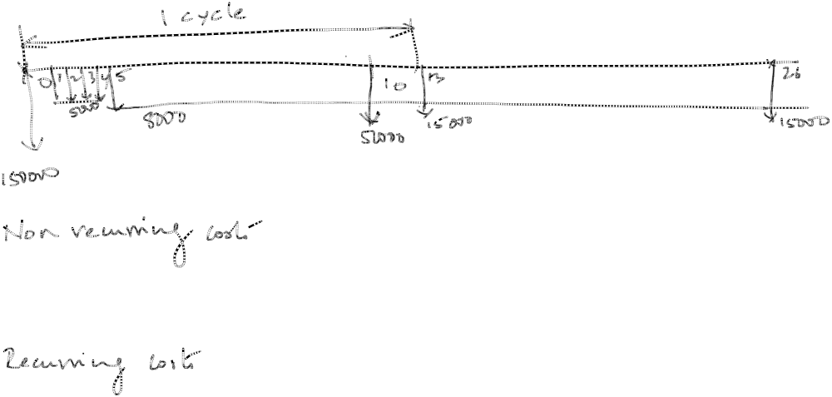

Slide 26


Recap
What is Future worth method
Numerical / Problems

